Slide 1
Environmental Modelling Project
Sarbajit Ghosh
21090015

Slide 2
Aims
To perform Monte-Carlo simulations of different variations of above trend growth for a particular part of the energy mix, with respect to other parts of the energy mix. The time period of the simulation is taken as the next 20 years
Create a test-bed project in order to do further research into how the carbon footprint would vary over the years, given different variations in the growth rate of parts of the energy mix.

Slide 3
Steps of the project
Collect Data (this was hard)
Clean the Data (harder)
Search for an adequate population model
Make projections for the population
Drink Coffee
Look for models to regress the population data with total energy capacity
Regress
Think about how to simulate, and what to simulate
Simulate
Housekeeping – directory management and VCS

Slide 4
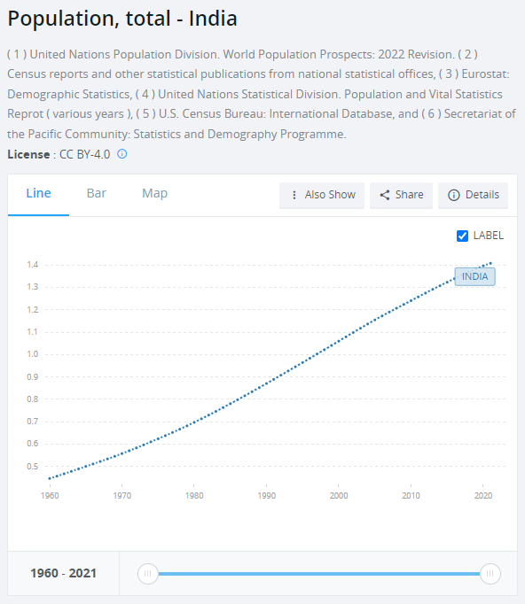
Data Collection
Population Data: https://data.worldbank.org/indicator/SP.POP.TOTL?locations=IN

Slide 5
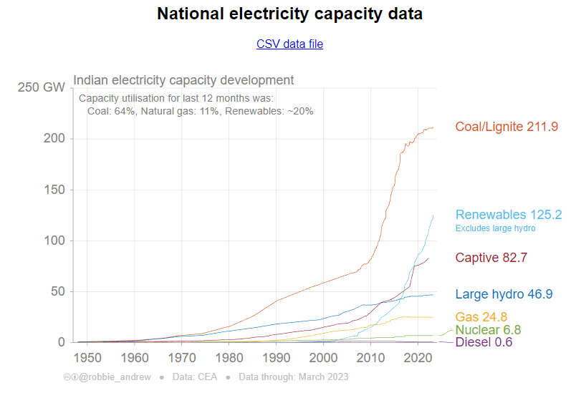
Data Collection
Energy Data: https://robbieandrew.github.io/india/
Collected from several sources, including https://npp.gov.in/

Slide 6
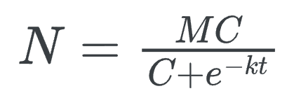
Projecting the Population
The Logistic Population Equation, in absence of predators and extinction events:
Carrying Capacity in my model: 2 billion

Slide 7
Let’s look at some code!

Slide 8
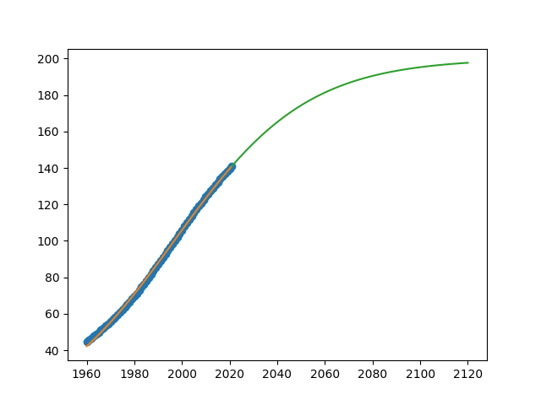
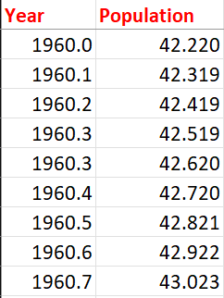
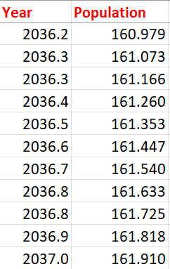
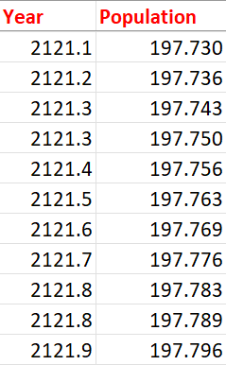
Projections
Population
Notice the S, in the logistic curve
Year

Slide 9
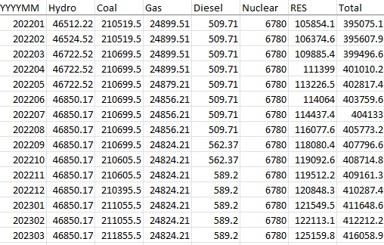
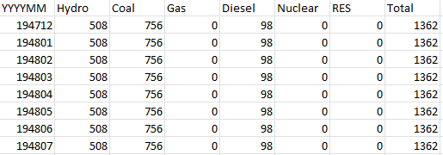
Cleaning the Energy Data
Oh god, it was horrible.
The date format
Why not linear interpolation?
Forward Fill and DropNa

Slide 10
Let’s look at some code!

Slide 11
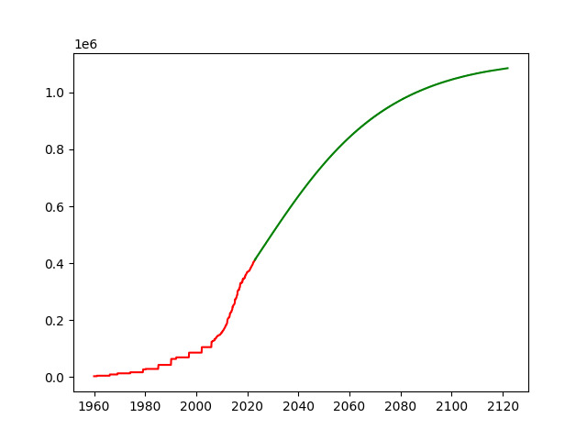
Regressing On Population
Linear Regression vs. Polyfit
Red: Data
Green: Projections based on regression
Continuity correction
Energy Capacity
Year

Slide 12
Assumptions and Notes
The Coefficient of Determination for the polynomial regression between the population and the energy output capacity is 0.88 (that’s pretty good)
Assumption: Energy Capacity in India will continue to rise with the population, given the propensity of internal energy policy to be self sufficient (no energy imports)
Assumption: There will be no significant changes in energy generation technology over the next 20 years (is this likely?)
Assumption: Each of the constituents will continue with its current trajectory (using implied growth of last ten years)
The simulation allows one of the energy constituents to increase with above trend growth (or below), while others continue at their implied growth level.

Slide 13
Let’s look at some simulation results!

Slide 14
What I could’ve done?
Regressed the population with energy capacity with some form of interpolation added to the missing values in the energy capacity data
Graphed the simulations better?
Ascertained a better limiting value for the population in the population model
Found a better method to ensure continuity (possibly by adding moving average corrections to the regression)

Slide 15
Further Research
Simulations with more than one part of the energy mix changing at the same time
Output the total carbon footprint of each scenario
Build a policy tool that comprehensively allows for viewing of different energy scenarios

Slide 16
Thank You!
Psst..
My Work is Infallible, don’t you dare ask any questions

